Slide 1

Data Manipulation Statements 4 June – 30 June 2012

Slide 2

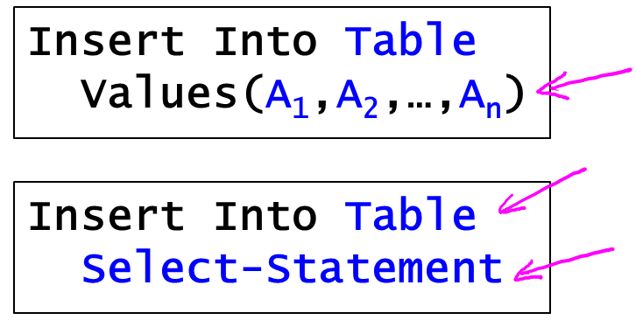
Data Manipulation
Inserting new data (2 methods)

Slide 3

Data Manipulation
Deleting existing data

Slide 4
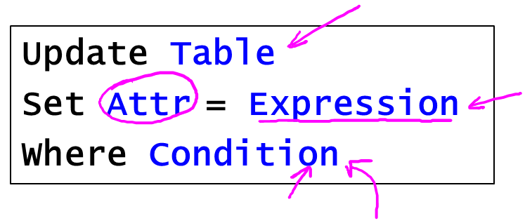
Data Manipulation
Updating existing data

Slide 5
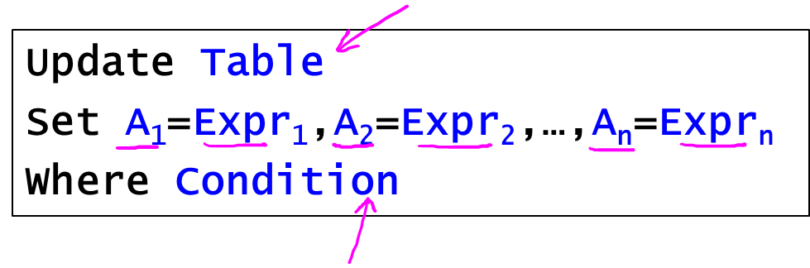
Data Manipulation
Updating existing data

Slide 6
Data Manipulation
Demo: SQLModifications.sql
Demo: simple college admissions database
College(cName,state,enrollment)
Student(sID,sName,GPA,sizeHS)
Apply(sID,cName,major,decision)

Slide 7


